Slide 1


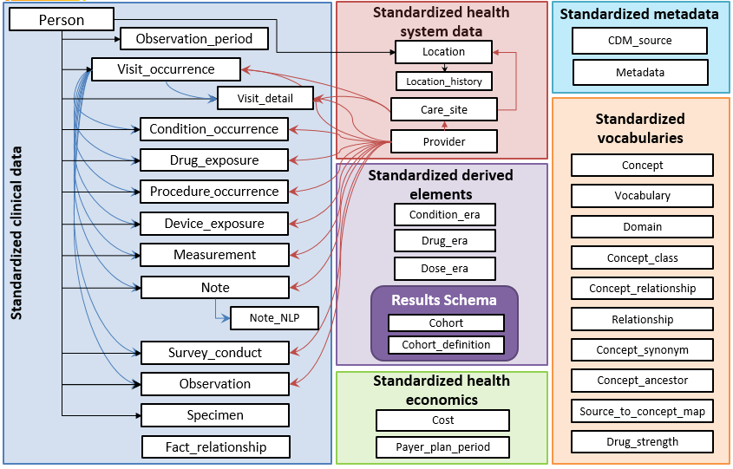
Open Community Standards Approach to Data Integrity & Reliable Evidence Generation
Standardized Structure (OMOP CDM)
Standardized Content (OMOP Vocab)
Standardized Conventions
(THEMIS)
Standardized Analytics (OHDSI Tools)
15
8
6
3
12
6
1
12
9
203 Shared Conventions developed by the THEMIS Workgroup
10
5
12
10
9
3
14
8
5
4
3
6
5
2
17
1
11
1
5
ACHILLES generates millions of summary statistics which can evaluate data quality
28
CDM Tables
2.8M Standard Concepts
203
Shared Conventions
1M+ Data Quality Point Checks
infinite possibilities to generate evidence that promotes better health decisions and care
https://www.ohdsi.org/
https://github.com/OHDSI/CommonDataModel/wiki

